Slide 1

K-hop Reachability

Slide 2
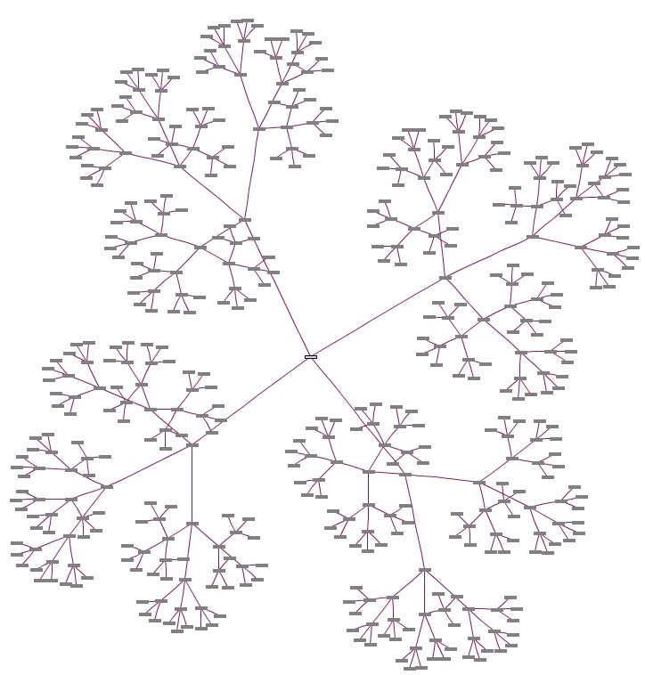
Outline
What’s K-hop Reachability problem?
FELINE Method
BFSI Method
ESTI Method
Optimization

Slide 3
What’s K-hop Reachability problem?
Determine whether there exists a directed path from u to v in the given directed graph and the path is not longer than k.
K-hop reachability queries is useful in many applications such as analysis of social networks and biological networks.

Slide 4
Outline
What’s K-hop Reachability problem?
FELINE Method
BFSI Method
ESTI Method
Optimization

Slide 5
FELINE Method

Slide 6
Fast rEfined onLINE search
We studied the following problem: given a DAG G , we need to determine if u can reach v.
FELINE creates an index from the graph representation in a two-dimensional plane, which provides reachability information in constant time for a significant portion of queries.

Slide 7
FELINE
Method
A
J
 | X | Y
A
B
C
D
G
H
I
J
1
2
B
C
7
Topological Order
8
G
5
3
4
H
I
D
6

Slide 8
FELINE Method
A
J
 | X | Y
A
B
C
D
G
H
I
J
1
2
2
3
B
C
7
4
8
7
G
5
8
3
5
4
6
H
I
D
6
1

Slide 9
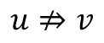
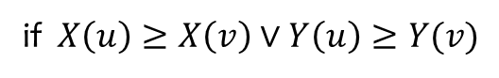
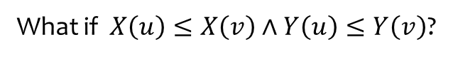
FELINE Method
A
J
 | X | Y
A
B
C
D
G
H
I
J
Can only determine the unreachability
1
2
2
3
7
4
$$u⇏v$$
B
C
8
7
G
5
8
if $X\left(u\right)≥X\left(v\right)∨Y\left(u\right)≥Y(v)$
3
5
4
6
H
I
I
D
6
1
What if $X\left(u\right)≤X\left(v\right)∧Y\left(u\right)≤Y\left(v\right)$?

Slide 10
FELINE Method
A
 | X | Y
A | 2 | 2
B | 1 | 4
C | 4 | 1
D | 5 | 3
E | 3 | 6
F | 6 | 5
B
C
E
D
F

Slide 11
Outline
What’s K-hop Reachability problem?
FELINE Method
BFSI Method
ESTI Method
Optimization

Slide 12
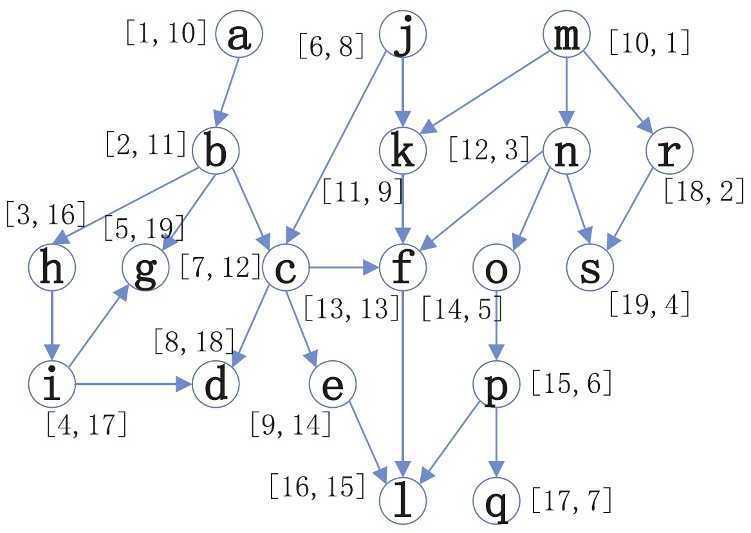
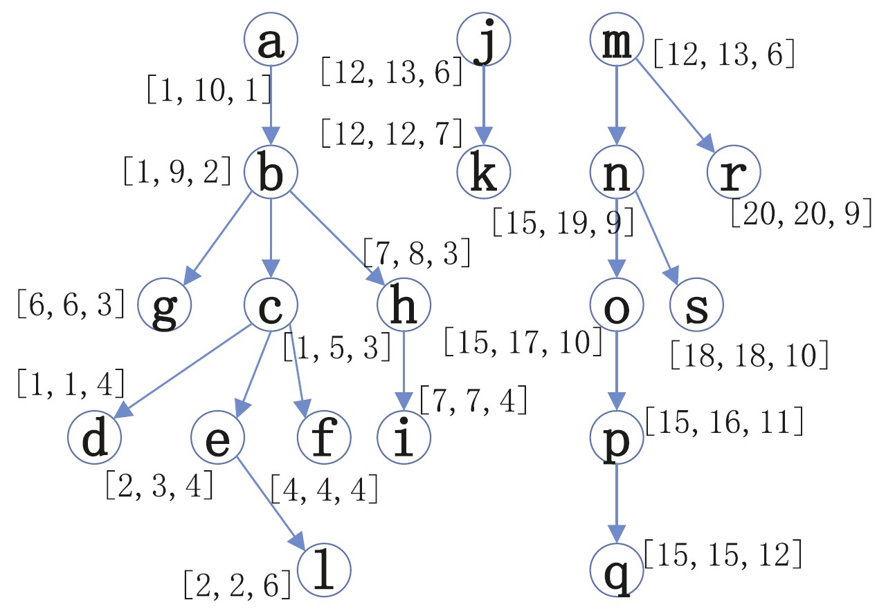
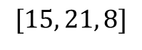
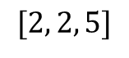
BFSI Method
$$[15, 21, 8]$$
$$[2, 2, 5]$$
FELINE Index
BFS Index
BFS Spanning Tree + DFS Index + BFS Level

Slide 13
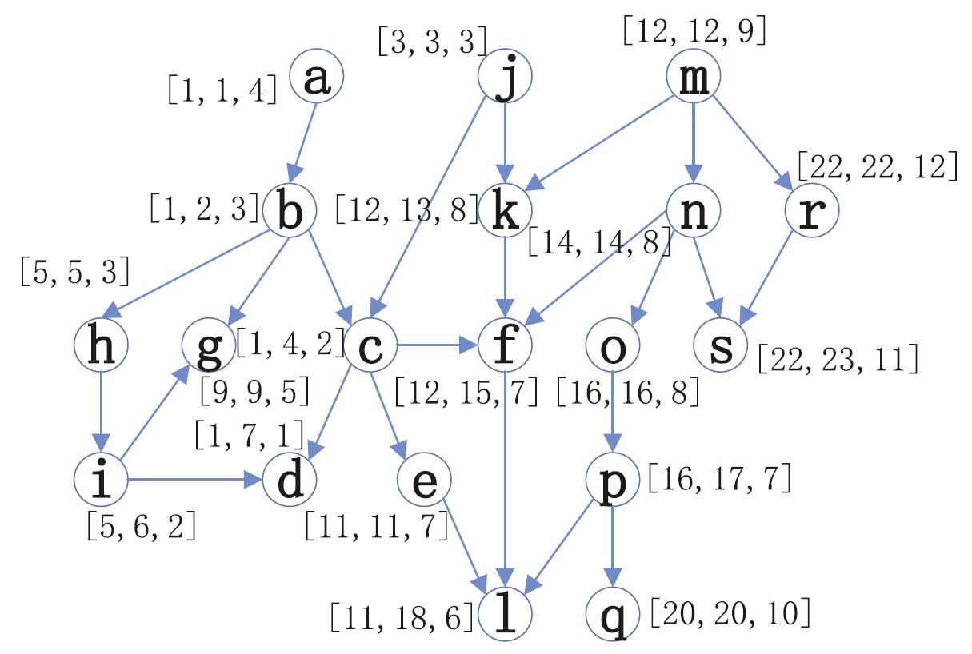
BFSI-B Method
Reversed graph
Start from node d
Sometimes the BFSI-B index is more scalable than that of the BFSI when the number of roots is larger than the set of leaves.

Slide 14
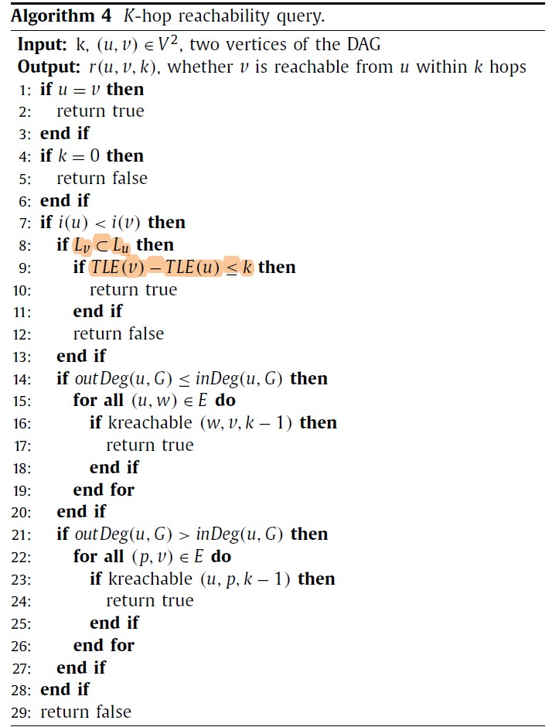
BFSI Method
BFSI Method
FELINE Prune
Recursion with BFSI-B

Slide 15
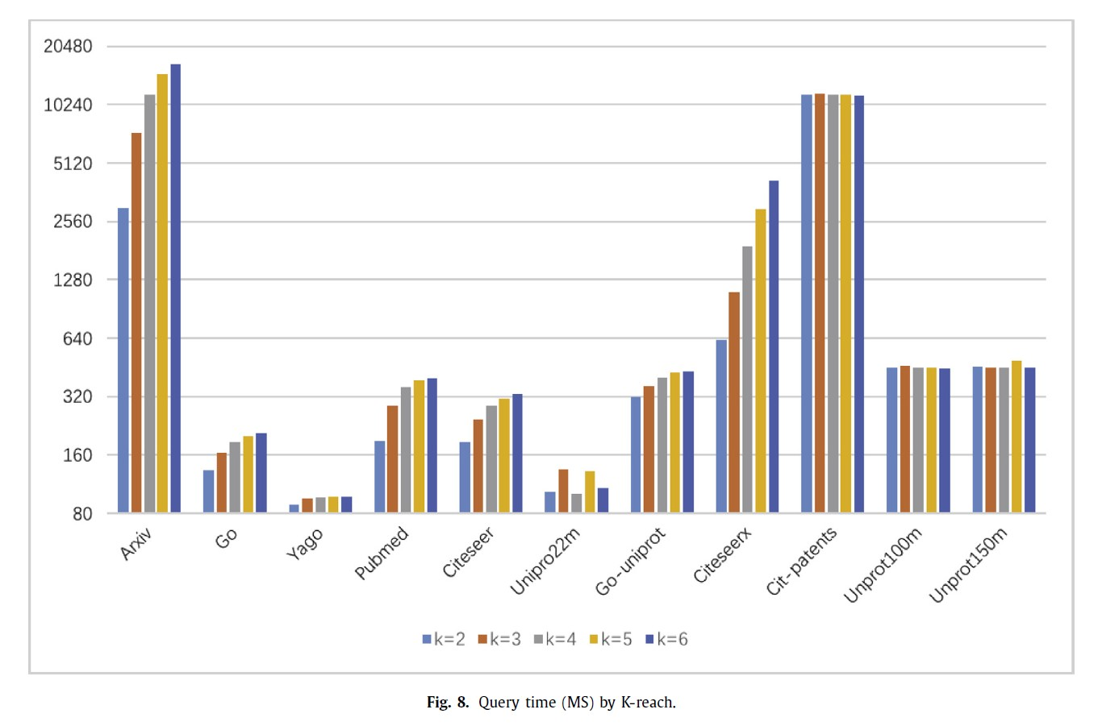
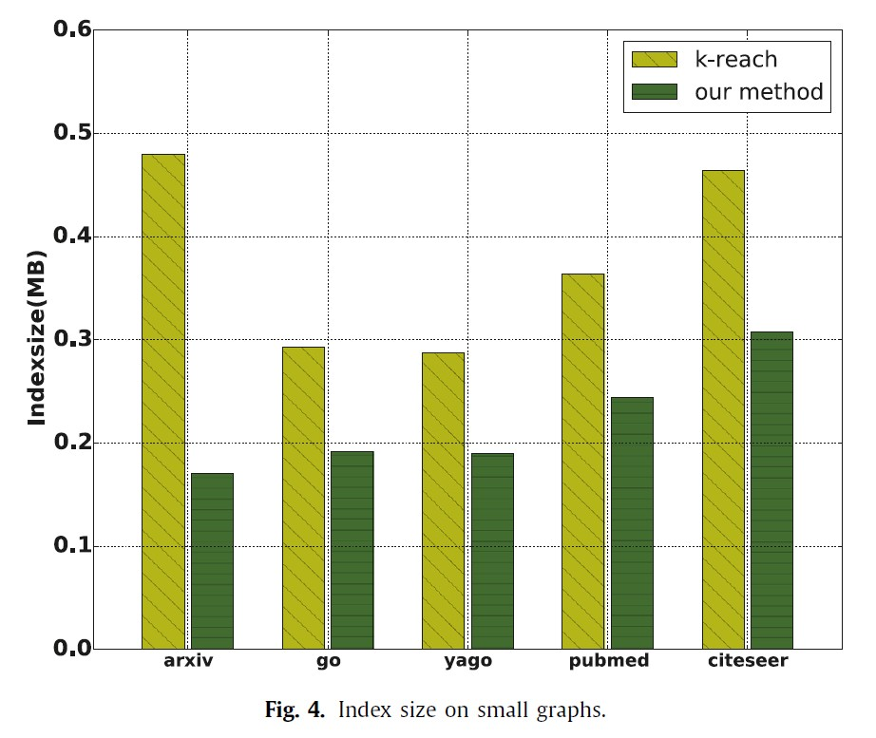
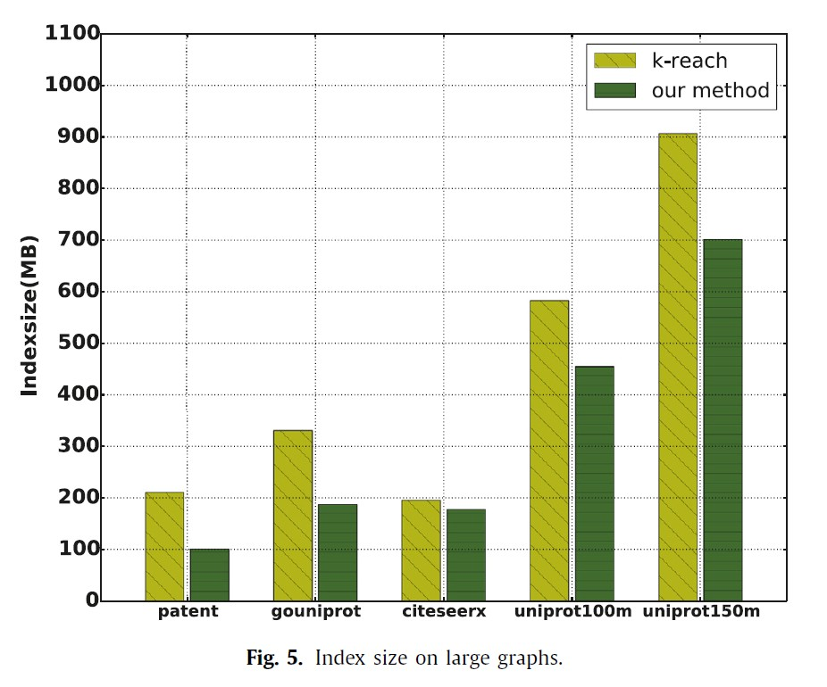
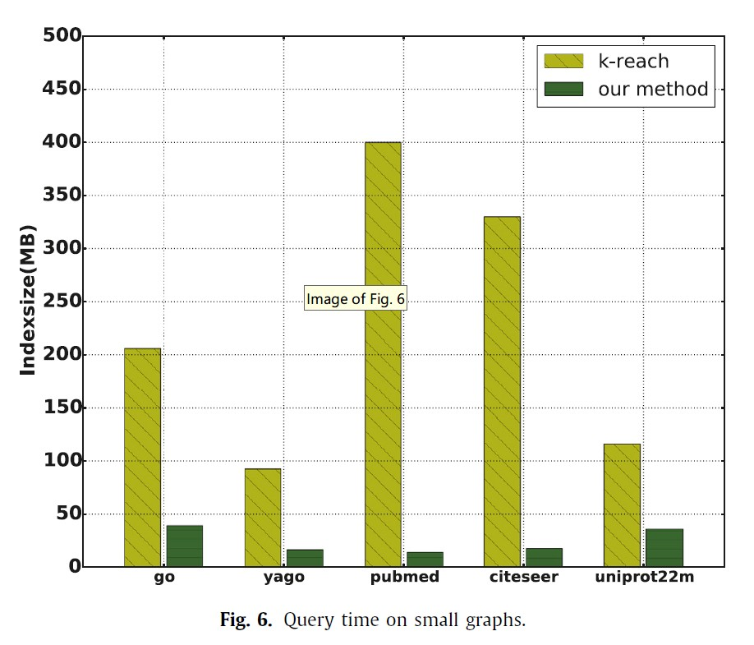
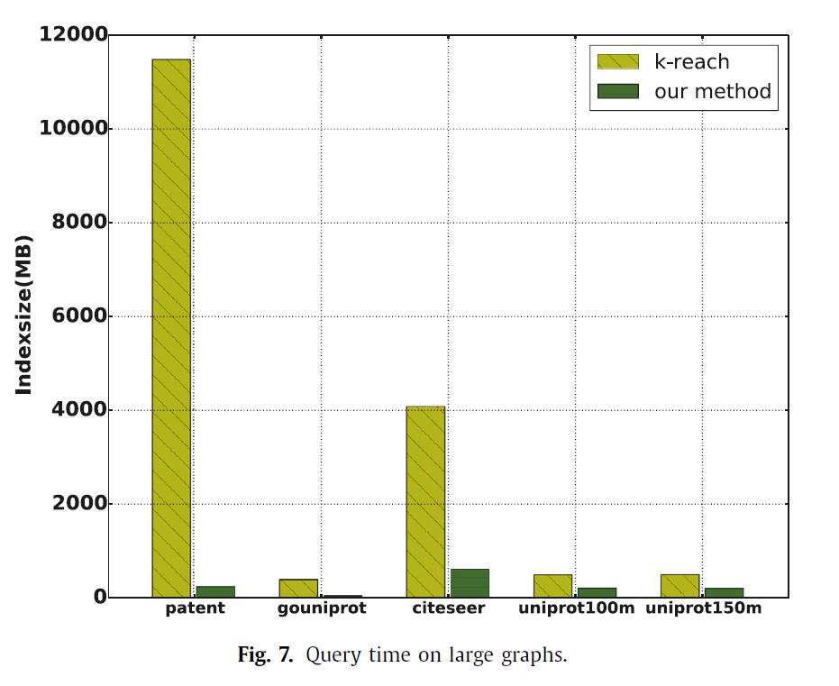
BFSI Method
Weakness:
Only work on DAG case

Slide 16
Outline
What’s K-hop Reachability problem?
FELINE Method
BFSI Method
ESTI Method
Optimization

Slide 17
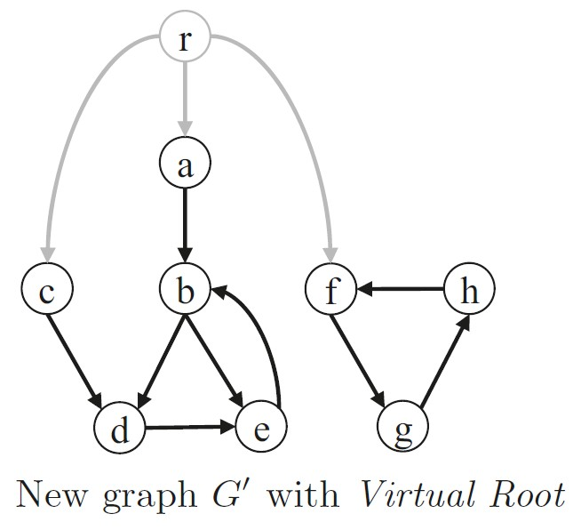
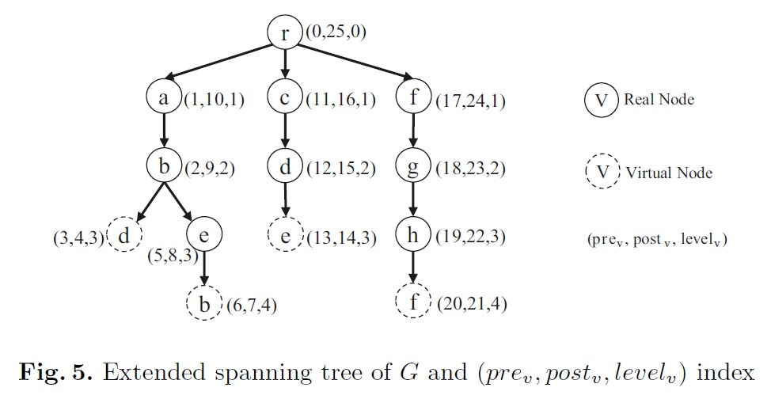
ESTI Method
BFS order

Slide 18
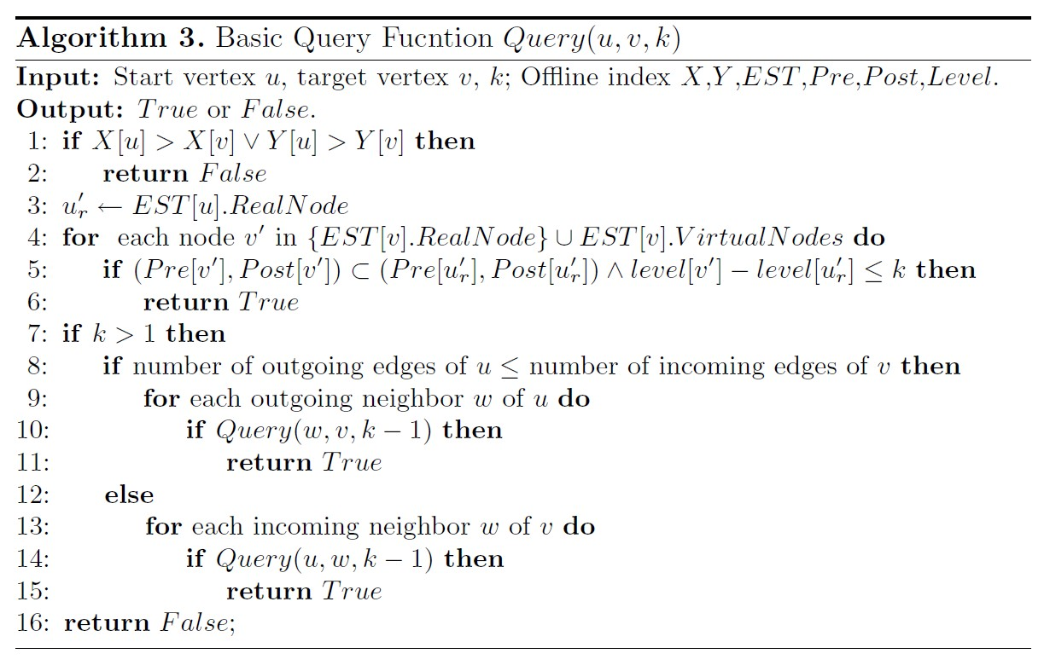
ESTI Method
FELINE
Same subtree
Jump

Slide 19
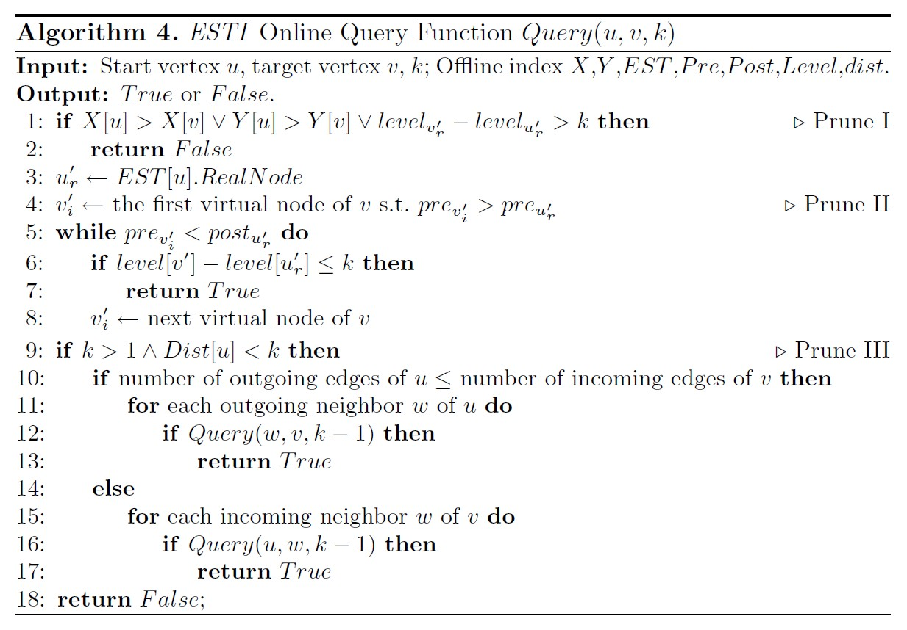
ESTI Method
Dist[u] represents the distance from u’s real node to the nearest virtual node among all successors.
Real Node
Same subtree
Jump

Slide 20
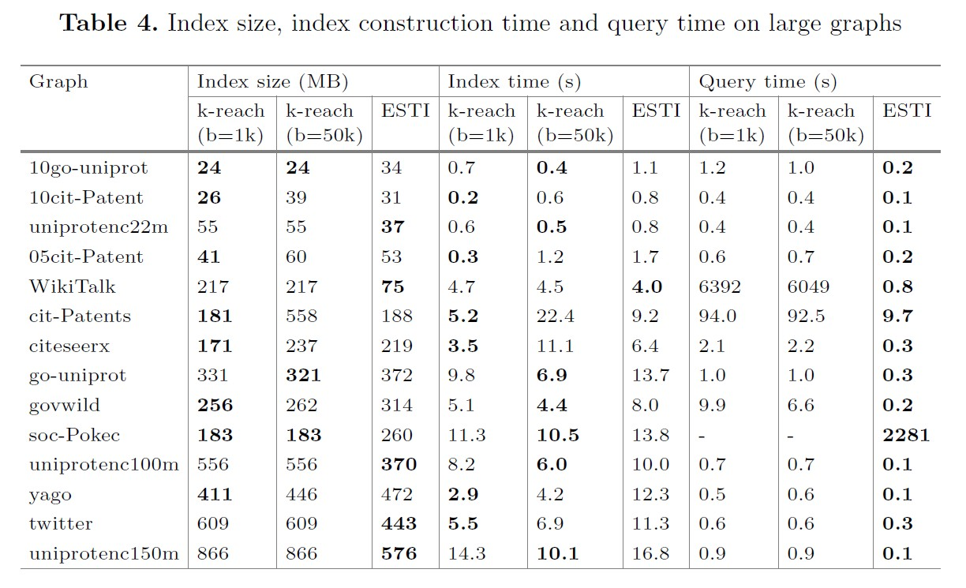
ESTI Method

Slide 21
Outline
What’s K-hop Reachability problem?
FELINE Method
BFSI Method
ESTI Method
Optimization

Slide 22



Optimization
Question:
Path $c⇒b≤2$ hops?
$X\left[c\right]≤X\left[b\right] Y\left[c\right]≤Y\left[b\right]$
$level\left[b\right]−level\left[c\right]≤2$
No b nodes in the same subtree as c, break loop
Recursion line9 ~ line18,
Optimization in step IV:
If $k>1∧Dist\left[u\right]<k:$
Dist[u] BFS, skip Prune II

Slide 23
Optimization
Parallel Computing

Slide 24

Thanks for your attention
References
Xie, Xia, et al. “BFSI-B: An Improved K-Hop Graph Reachability Queries for Cyber-Physical Systems.” Information Fusion, vol. 38, Nov. 2017, pp. 35–42. DOI.org (Crossref), https://doi.org/10.1016/j.inffus.2017.02.009.
Cai, Yuzheng, and Zheng, Weiguo. “ESTI: Efficient k-Hop Reachability Querying over Large General Directed Graphs.” DASFAA, 2021.
Li Zhou, Ren Chen, Yinglong Xia and Radu Teodorescu. "C-Graph: A Highly Efficient Concurrent Graph Reachability Query Framework." ICPP 2018, https://doi.org/10.1145/3225058.3225136.

